Slide 1
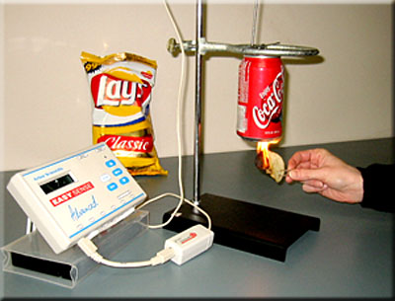
Metabolic Diseases Lesson 1.4
Part 1: Nutrients and the calorie:
What food’s in your food?

Slide 2
Do Now
What are the main components of food and what does the body use them for?
Carbohydrates, Fats/Lipids, and Protein
Vitamins and Minerals
Indigestible plant components like fiber

Slide 3
Do Now
What are the main components of food and what does the body use them for?
Carbohydrates, Fats/Lipids, and Protein - the body uses them for calories and structures.
Vitamins and Minerals – the body uses them to help proteins (such as enzymes) perform important functions.
Indigestible plant components like fiber - the body uses them to help digestion.

Slide 4
The calorie: What is it?

Slide 5
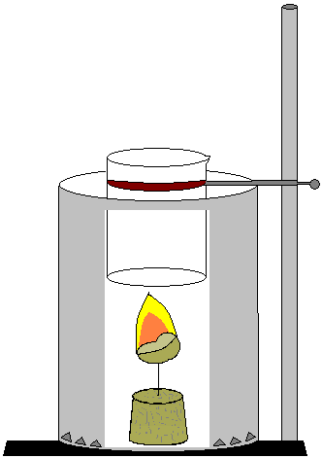
Activity Calorimetry Lab
Measuring calories in food

Slide 6
A calorie is a measurement of energy It is the amount of energy that is needed to raise the temperature of 1 gram of water by one degree Celsius

Slide 7
Wrap Up
What is the relationship between the release of energy in the form of heat and calories?
Do all macronutrients provide the same number of calories?

Slide 8
Wrap Up
Different macronutrients provide different amounts of calories!

Slide 9
Homework
Finish off the virtual calorimetry lab and answer the following question:
Were you surprised by any of your findings?

